Slide 1
1
“There is hope, even when your brain tells you there isn’t.”
- John Green
2
“Just because no one else can heal or do your inner work for you doesn’t mean you can, should, or need to do it alone.”
- Lisa Olivera
3
“Not until we are lost do we begin to understand ourselves.”
- Henry David Thoreau

Slide 2
1
“There is hope, even when your brain tells you there isn’t.”
- John Green
2
“Just because no one else can heal or do your inner work for you doesn’t mean you can, should, or need to do it alone.”
- Lisa Olivera
3
“Not until we are lost do we begin to understand ourselves.”
- Henry David Thoreau

Slide 3
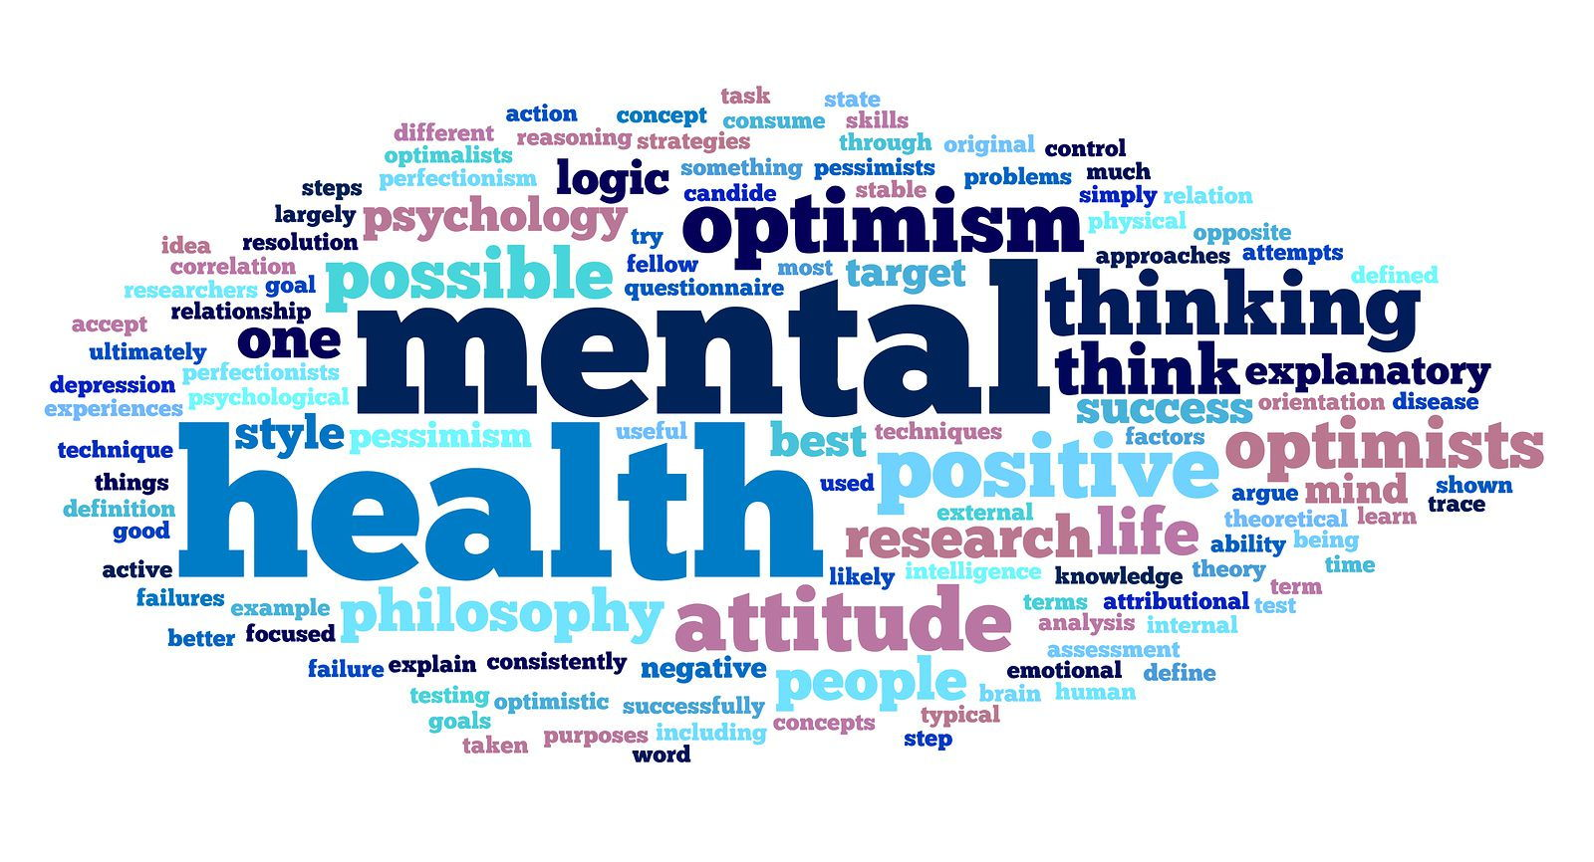

Slide 4


Mental Health and Well-being
CCCA3 Lesson 07

Slide 5
Learning outcomes
By the end of this session, you will be able to:
  Use listening skills to answer questions about a short video.
  Develop vocabulary related to mental health.
  Recognise the importance of maintaining a positive mental health.
  Use present perfect simple and continuous correctly.

Slide 6
Outline
1
Mental health: definition
2
Mental health vs. mental illness
3
Warning signs of mental illness
4
Positive mental health
5
Causes of mental illness
6
Grammar: Present perfect (simple vs. continuous)

Slide 7

What is mental health?

Slide 8
What does mental health include?
What does it affect?
At what stage of life is mental health important?
What does it help us do?

Slide 9
Mental health includes our emotional, psychological, and social well-being.
Mental health is important at every stage of life, from childhood and adolescence through adulthood
It affects how we think, feel, and act. It also helps determine how we handle stress, relate to others, and make healthy choices.
Source: https://www.cdc.gov/mentalhealth/learn/index.htm

Slide 10
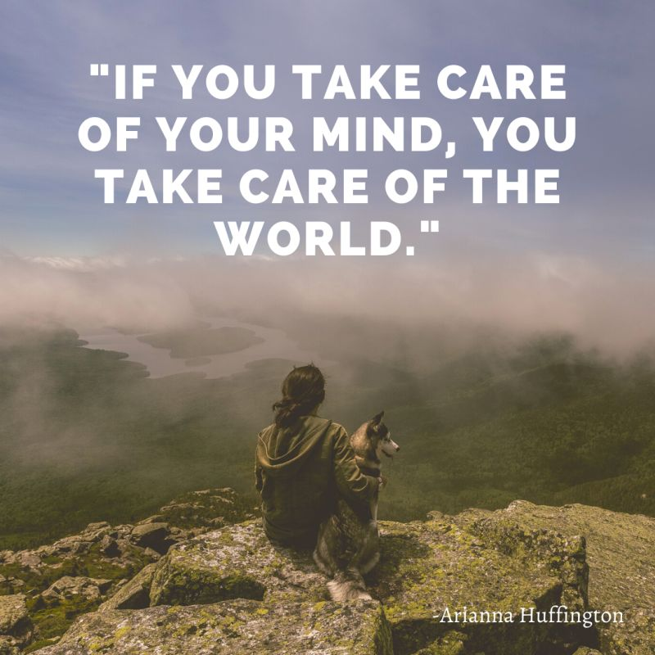


Slide 11
What are the most common mental health illnesses?

Slide 12
Anxiety Disorders
In 2019, 301 million people were living with an anxiety disorder including 58 million children and adolescents.
Types of Anxiety Disorders
Generalised anxiety disorder
Panic disorder
Social anxiety disorder
Separation anxiety disorder
characterised by excessive worry
characterised by panic attacks
characterised by excessive fear and worry in social situations
characterised by excessive fear or anxiety about separation from those individuals to whom the person has a deep emotional bond

Slide 13
Depression
In 2019, 280 million people were living with depression, including 23 million children and adolescents.
Depression is different from usual mood fluctuations and short-lived emotional responses to challenges in everyday life.

Slide 14
Bipolar Disorder
Depression
In 2019, 40 million people experienced bipolar disorder.
In 2019, 280 million people were living with depression, including 23 million children and adolescents
People with bipolar disorder experience alternating depressive episodes with periods of manic symptoms. During a depressive episode, the person experiences depressed mood (feeling sad, irritable, empty) or a loss of pleasure or interest in activities, for most of the day, nearly every day.
Depression is different from usual mood fluctuations and short-lived emotional responses to challenges in everyday life.

Slide 15
Schizophrenia
Bipolar Disorder
Depression
In 2019, 40 million people experienced bipolar disorder
In 2019, 280 million people were living with depression, including 23 million children and adolescents
Schizophrenia affects approximately 24 million people or 1 in 300 people worldwide.
People with bipolar disorder experience alternating depressive episodes with periods of manic symptoms. During a depressive episode, the person experiences depressed mood (feeling sad, irritable, empty) or a loss of pleasure or interest in activities, for most of the day, nearly every day.
Depression is different from usual mood fluctuations and short-lived emotional responses to challenges in everyday life.
Schizophrenia is characterised by significant impairments in perception and changes in behaviour. Symptoms may include persistent delusions, hallucinations, disorganised thinking, highly disorganised behaviour, or extreme agitation.
Source: https://www.who.int/news-room/fact-sheets/detail/mental-disorders

Slide 16
How can a person’s mental health problems impact their relationships with others?

Slide 17
Most relationships experience their own challenges, but if one or both of the partners are struggling with mental health issues, these challenges can be exacerbated. This is because the mental illness of one partner can impact the mental health of the other, and vice versa.

Slide 18
Choose the correct definition for the vocabulary words as used in the sentences.
1) Thrive means...
make something a goal or target
not be afraid to try new things
grow or succeed quickly
2) Chronic cigarette smoking can lead to very serious health issues. Chronic means...
prolonged or lasting a long time
occasional or happening once in a while
spontaneous or happening randomly
3) People who are depressed may be afraid to tell others because of the stigma attached to feelings of depression. Stigma refers to...
highly disapproved methods
generally negative attitudes
strong evidence or proof
4) Being resilient is an important trait to have after losing a competition. Resilient means...
able to deal with failure well
able to feel sorry or pity for oneself
able to predict future circumstances

Slide 19
Let’s watch a video about mental health and answer the following questions
1) What factors can affect a person’s mental health?
  Our genetic make-up, upbringing, our life circumstances, or the stresses we are under.
2) What are the signs that someone is “mentally healthy”?
  Being mentally healthy means being resilient and able to cope with difficult times, feeling in control, being confident, feeling good about yourself, managing and expressing your emotions, and building and maintaining good relationships.
3) What are the potential consequences of leaving a mental health issue untreated?
  They significantly have an impact on daily functioning and frequently interfere with family, social, and work responsibilities.
‹#›

Slide 20
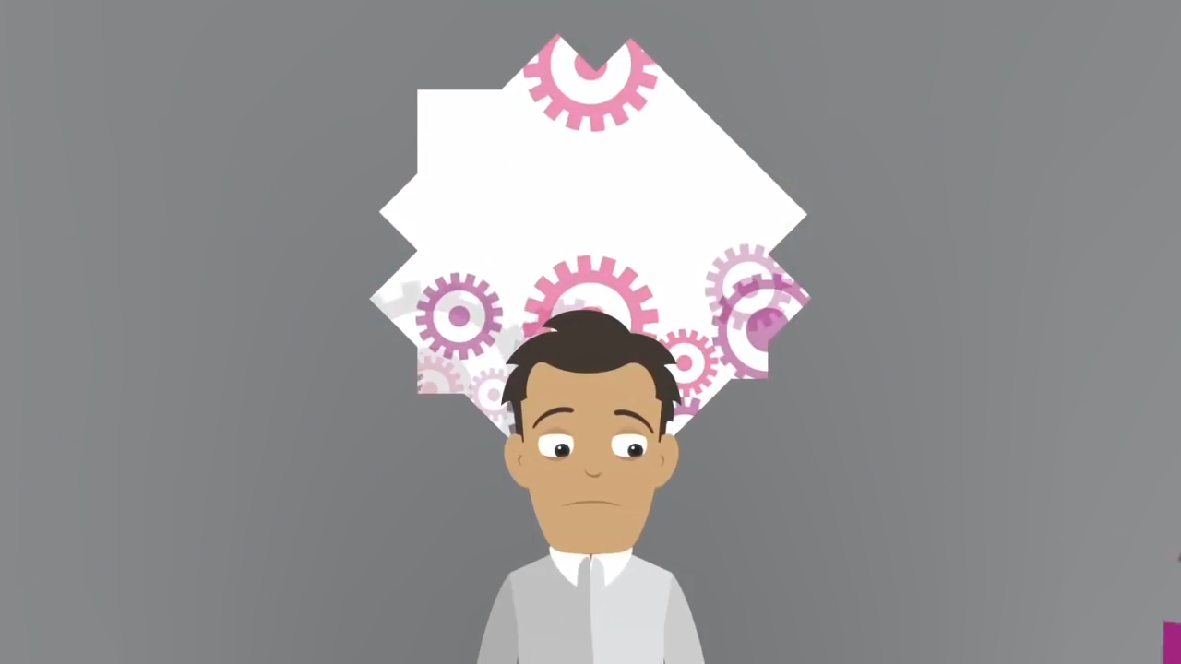

Slide 21
1) What factors can affect a person’s mental health?
  Our genetic make-up, upbringing, our life circumstances, or the stresses we are under.
2) What are the signs that someone is “mentally healthy”?
  Being mentally healthy means being resilient and able to cope with difficult times, feeling in control, being confident, feeling good about yourself, managing and expressing your emotions, and building and maintaining good relationships.
3) What are the potential consequences of leaving a mental health issue untreated?
  They significantly have an impact on daily functioning and frequently interfere with family, social, and work responsibilities.

Slide 22
1) What factors can affect a person’s mental health?
  Our genetic make-up, upbringing, our life circumstances, or the stresses we are under.
2) What are the signs that someone is “mentally healthy”?
  Being mentally healthy means being resilient and able to cope with difficult times, feeling in control, being confident, feeling good about yourself, managing and expressing your emotions, and building and maintaining good relationships.
3) What are the potential consequences of leaving a mental health issue untreated?
  They significantly have an impact on daily functioning and frequently interfere with family, social, and work responsibilities.

Slide 23
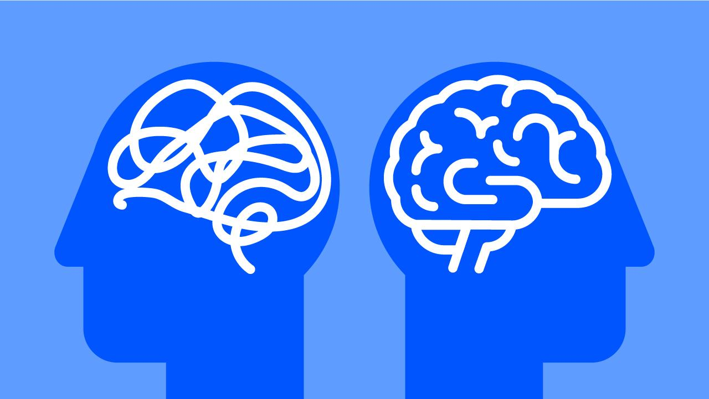
Mental Health vs.
Mental Illness

Slide 24

Mental health
Mental illness
Reflects “our emotional, psychological, and social well-being.”
Refers to “conditions that affect a person’s thinking, feeling, mood, or behavior.” These can include but aren’t limited to depression, anxiety, bipolar disorder, or schizophrenia.
The mental equivalent of physical health
The mental equivalent of physical illness

Slide 25
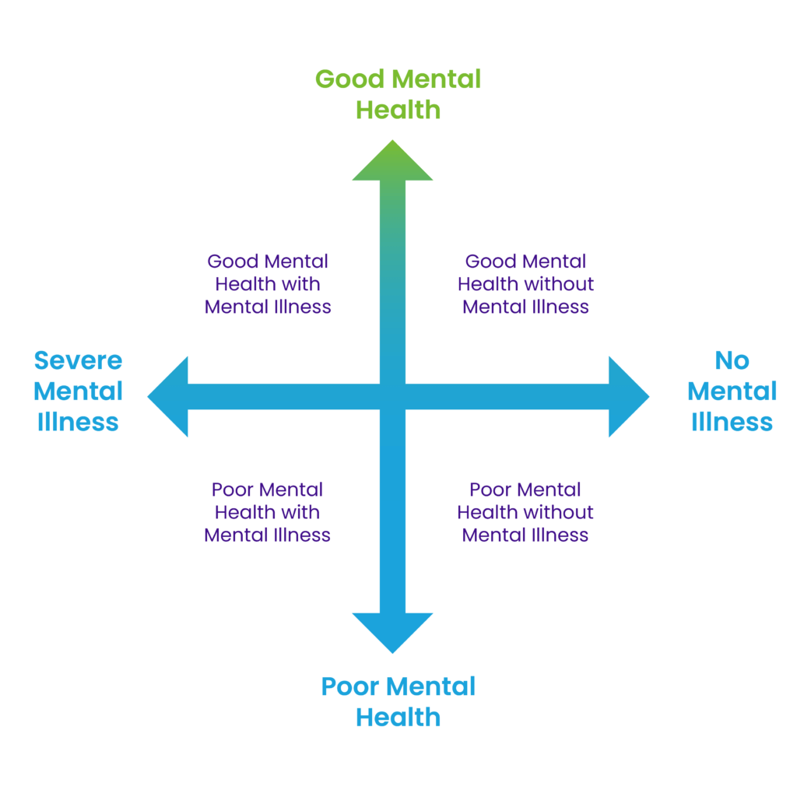
The dual continuum of mental health
Source: https://smho-smso.ca/students/understanding-mental-health/

Slide 26
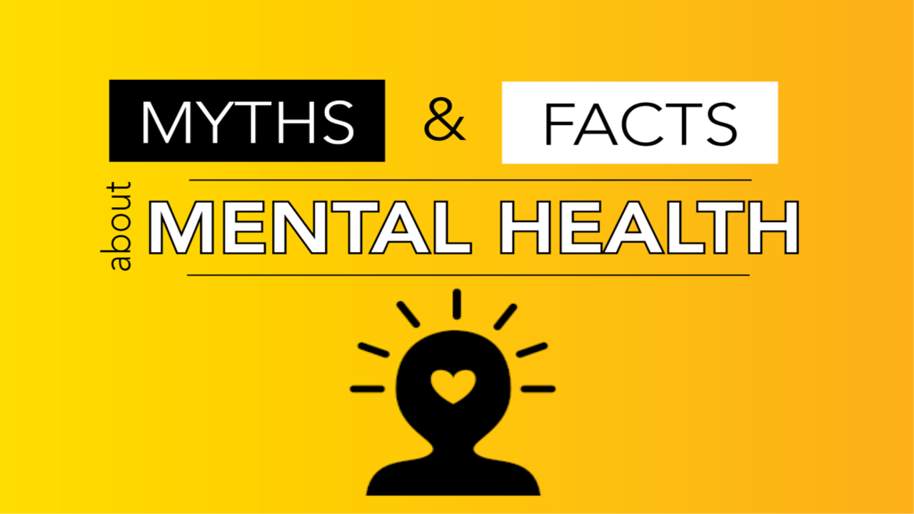

Slide 27
1
Myth: Mental health problems don't affect me.
Fact: Mental health problems are actually very common. In 2020, about:
One in five American adults experienced a mental health issue
One in 6 young people experienced a major depressive episode
3
Myth: There is no hope for people with mental health problems. Once a friend or family member develops mental health problems, he or she will never recover.
Fact: Studies show that people with mental health problems get better and many recover completely. There are more treatments, services, and community support systems than ever before, and they work.
2
Myth: Personality weakness causes mental health problems. People with mental health problems can snap out of it if they try hard enough.
Fact: Many factors contribute to mental health problems, including:
Biological factors, such as genes, physical illness, injury, or brain chemistry
Life experiences, such as trauma or a history of abuse
Family history of mental health problems
4
Myth: I can't do anything for a person with a mental health problem.
Fact: Friends and family can be important influences to help someone get the treatment and services they need by:
Reaching out and letting them know you are available to help
Learning and sharing the facts about mental health
Treating them with respect, just as you would anyone else

Slide 28
1
Myth: Mental health problems don't affect me.
Fact: Mental health problems are actually very common. In 2020, about:
One in five American adults experienced a mental health issue
One in 6 young people experienced a major depressive episode
2
Myth: Personality weakness causes mental health problems. People with mental health problems can snap out of it if they try hard enough.
Fact: Many factors contribute to mental health problems, including:
Biological factors, such as genes, physical illness, injury, or brain chemistry
Life experiences, such as trauma or a history of abuse
Family history of mental health problems
3
Myth: There is no hope for people with mental health problems. Once a friend or family member develops mental health problems, he or she will never recover.
Fact: Studies show that people with mental health problems get better and many recover completely. There are more treatments, services, and community support systems than ever before, and they work.
4
Myth: I can't do anything for a person with a mental health problem.
Fact: Friends and family can be important influences to help someone get the treatment and services they need by:
Reaching out and letting them know you are available to help
Learning and sharing the facts about mental health
Treating them with respect, just as you would anyone else

Slide 29
Early warning signs of mental illness
Eating or sleeping too much or too little
Pulling away from people and usual activities
Having low or no energy
Feeling numb or like nothing matters
Having unexplained aches and pains
Feeling helpless or hopeless
Smoking, drinking, or using drugs more than usual
Feeling unusually confused, forgetful, on edge, angry, upset, worried, or scared
Yelling or fighting with family and friends
Experiencing severe mood swings that cause problems in relationships
Having persistent thoughts and memories you can't get out of your head
Hearing voices or believing things that are not true
Thinking of harming yourself or others
Inability to perform daily tasks like taking care of your kids or getting to work or school
Source: https://www.mentalhealth.gov/basics/what-is-mental-health

Slide 30

Facts and statistics

Slide 31
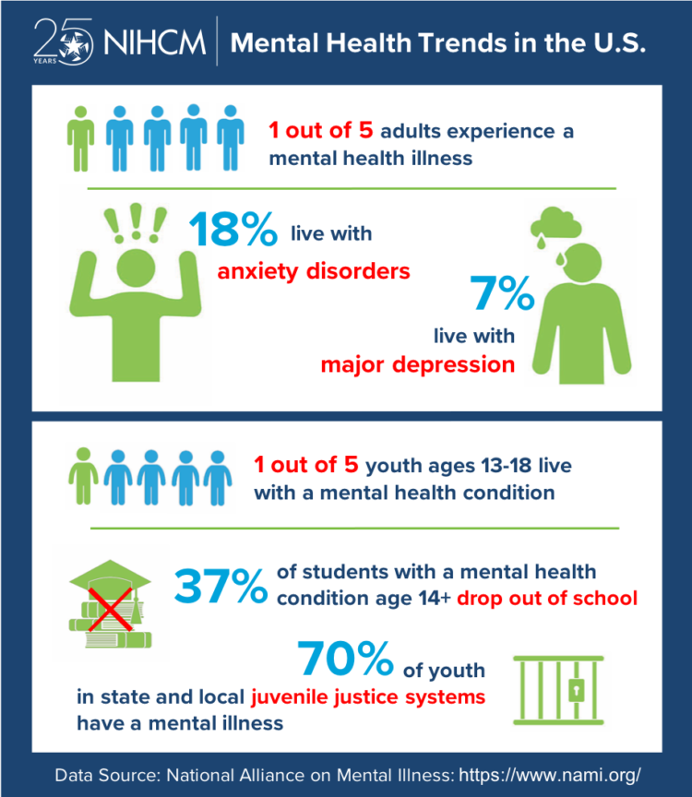

Slide 32
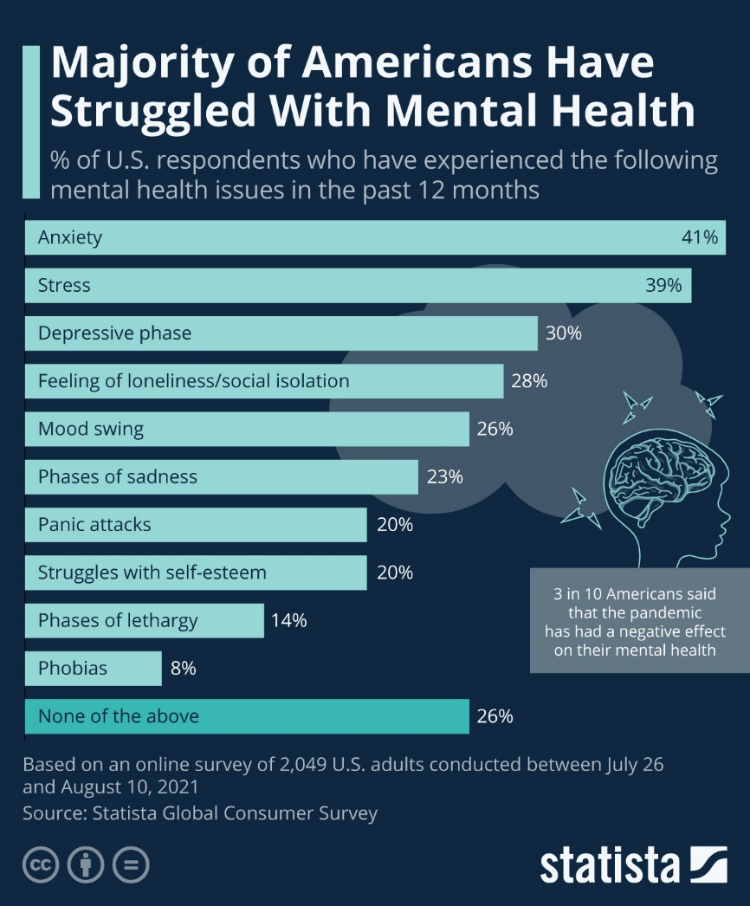

Slide 33
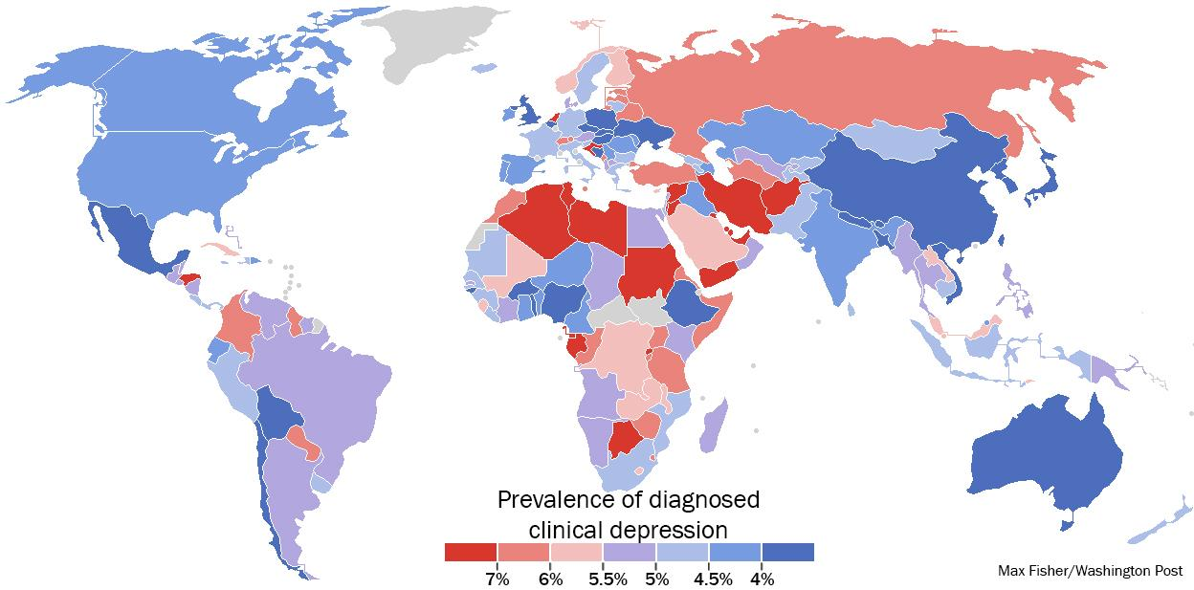

Slide 34
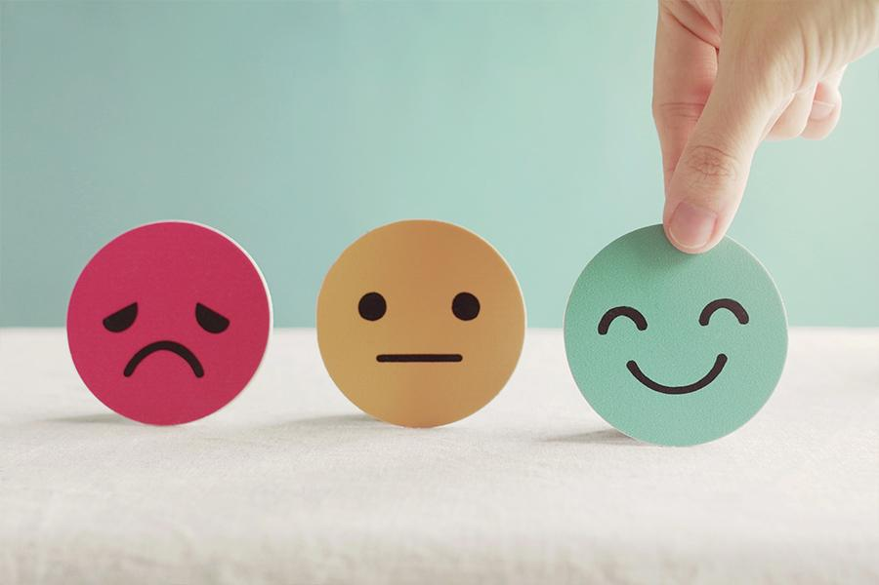
Positive mental health

Slide 35
What is positive mental health?
Positive mental health is defined as a state of well-being where individuals are able to:
Realise their own potential
Work productively
Cope with the normal stresses of life
Make a positive contribution to the community.
Source: https://www.cbhs.com.au/mind-and-body/blog/what-is-positive-mental-health-and-how-can-we-foster-it

Slide 36
Other features of positive mental health include:
feeling positive emotions like optimism, happiness, love, compassion, satisfaction and joy.
goal-setting
having confidence in new situations
avoiding self-blame
having good self-esteem.
Source: https://www.cbhs.com.au/mind-and-body/blog/what-is-positive-mental-health-and-how-can-we-foster-it

Slide 37

How to maintain a positive mental health?

Slide 38
Ways to maintain positive mental health include:
Getting professional help if you need it
Connecting with others
Taking time for yourself
Getting physically active
Finding purpose and meaning
Eating well
Staying positive
Getting enough sleep
Helping others or volunteering
Relaxing, meditating, or practicing mindfulness
Developing coping skills such as reading, meditation and spirituality
Source: https://www.midhelps.org/mental-health/wellness/

Slide 39


Slide 40
Fill in the blanks with the words from the box:
illness/ conditions/ serious/ anxious/ healthy/ well-being
well- being
Mental health is a state of ……………… of the mind and emotions. A person who is mentally ………………. can face day to day problems that occur. This is hard for a person who is not mentally healthy. This person’s feelings, thoughts or relationships can make him or her feel very ………………. . There are many types of mental health ………………. . Anxiety disorders, depression, and addiction problems are common types of mental health conditions. A mental health condition may be so ……………….. that it can become a mental ………………..
healthy
anxious
conditions
serious
illness

Slide 41

What causes mental illness?

Slide 42
Causes of mental illness
There is no single cause for mental illness. A number of factors can contribute to risk for mental illness, such as:
Early adverse life experiences, such as trauma or a history of abuse (for example, child abuse, sexual assault, witnessing violence, etc.)
Experiences related to other ongoing (chronic) medical conditions, such as cancer or diabetes
Biological factors or chemical imbalances in the brain
Use of alcohol or drugs
Having feelings of loneliness or isolation
Source: https://www.cdc.gov/mentalhealth/learn/index.htm

Slide 43
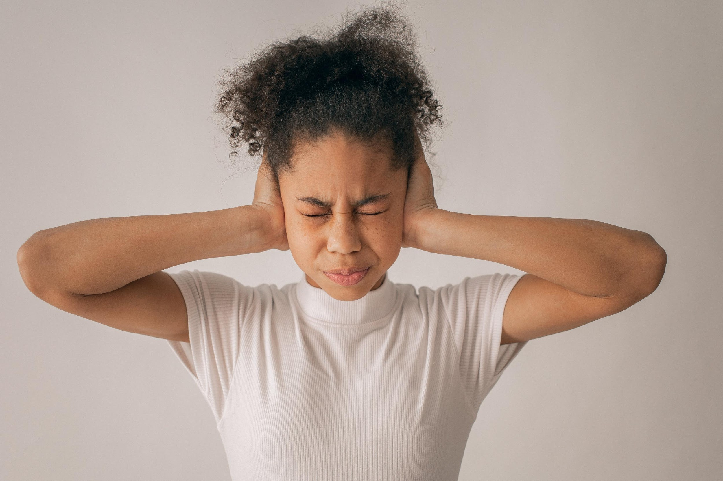
Case study (anxiety)
Mariam is a 12-year-old girl. She always appears worried and frequently bites her nails. She frequently leaves class with complaints of a headache that only occurs during school days. She is always worried about her family and if something bad would happen to them while she is at school, worried about her health and what will happen if she gets ill and worried about what others think of her. Sometimes when she gets anxious she feels her heart pounding and her body trembling, she becomes short of breath and starts to feel sweaty. She realizes that her worries are excessive but feels helpless confronting them.

Slide 44
Discussion:
What strategies could be implemented by the teachers, the parents and the peers to support Mariam?
Who else could support Mariam and how?
When would you refer Mariam to a specialist?

Slide 45

Mental health and friendship.

Slide 46

Friendship is a crucial element in protecting our mental health. Our friends can keep us grounded, help us get things in perspective, and help us manage life's problems.

Slide 47
Testimonials
“The best thing my friend did for me was that they just accepted me as I was.”
“They kept coming to see me even though I didn’t seem to want them and they made me laugh.”
“I wanted my friends to know so they...would cut me some slack if I behaved oddly.”
“My friend asked me questions, didn’t just assume things, she really wanted to know.”
“My friend realised I had taken an overdose and rang for an ambulance... but has never judged me or criticised my action.”
“My friend phoned me, talked to me about normal stuff, sent me letters, took me out sometimes.”
Source: https://www.mentalhealth.org.uk/explore-mental-health/a-z-topics/friendship-and-mental-health

Slide 48

Let’s take a quiz!

Slide 49
Choose the correct option:
1) Having a mental illness can affect the way that a person
behaves
thinks
feels
all of the above
2) Another way to talk about mental illness is to say
mental health challenge
mental wellness
mental malfunction
disordered mentality
3) What is the least effective way of dealing with a mental health challenge or mental illness?
telling a trusted adult how you feel
staying at a hospital for a brief period of time
keeping feelings bottled up inside
meeting with a mental health professional
4) What is not considered a mental health challenge?
Anxiety
Anger
Depression
Eating Disorder
5) When someone is often nervous and experiences panic attacks, it is called:
An eating disorder
Depression
Anxiety
Autism
6) When someone finds it hard to finish things and finds it hard to sit still and focus his or her thoughts it could be:
Attention Deficit Hyperactivity Disorder (ADHD)
Nervous Leg Syndrome
Eating Disorder
Attention Deficit Syndrome

Slide 50
What is the tense and form of the underlined verbs in each sentence?
10 October has been the World Mental Health Day since 1992.
Present perfect simple
Present perfect continuous
The World Health Organisation has been working with partners to launch a campaign around the theme “Making Mental Health & Well-Being for All a Global Priority.”

Slide 51
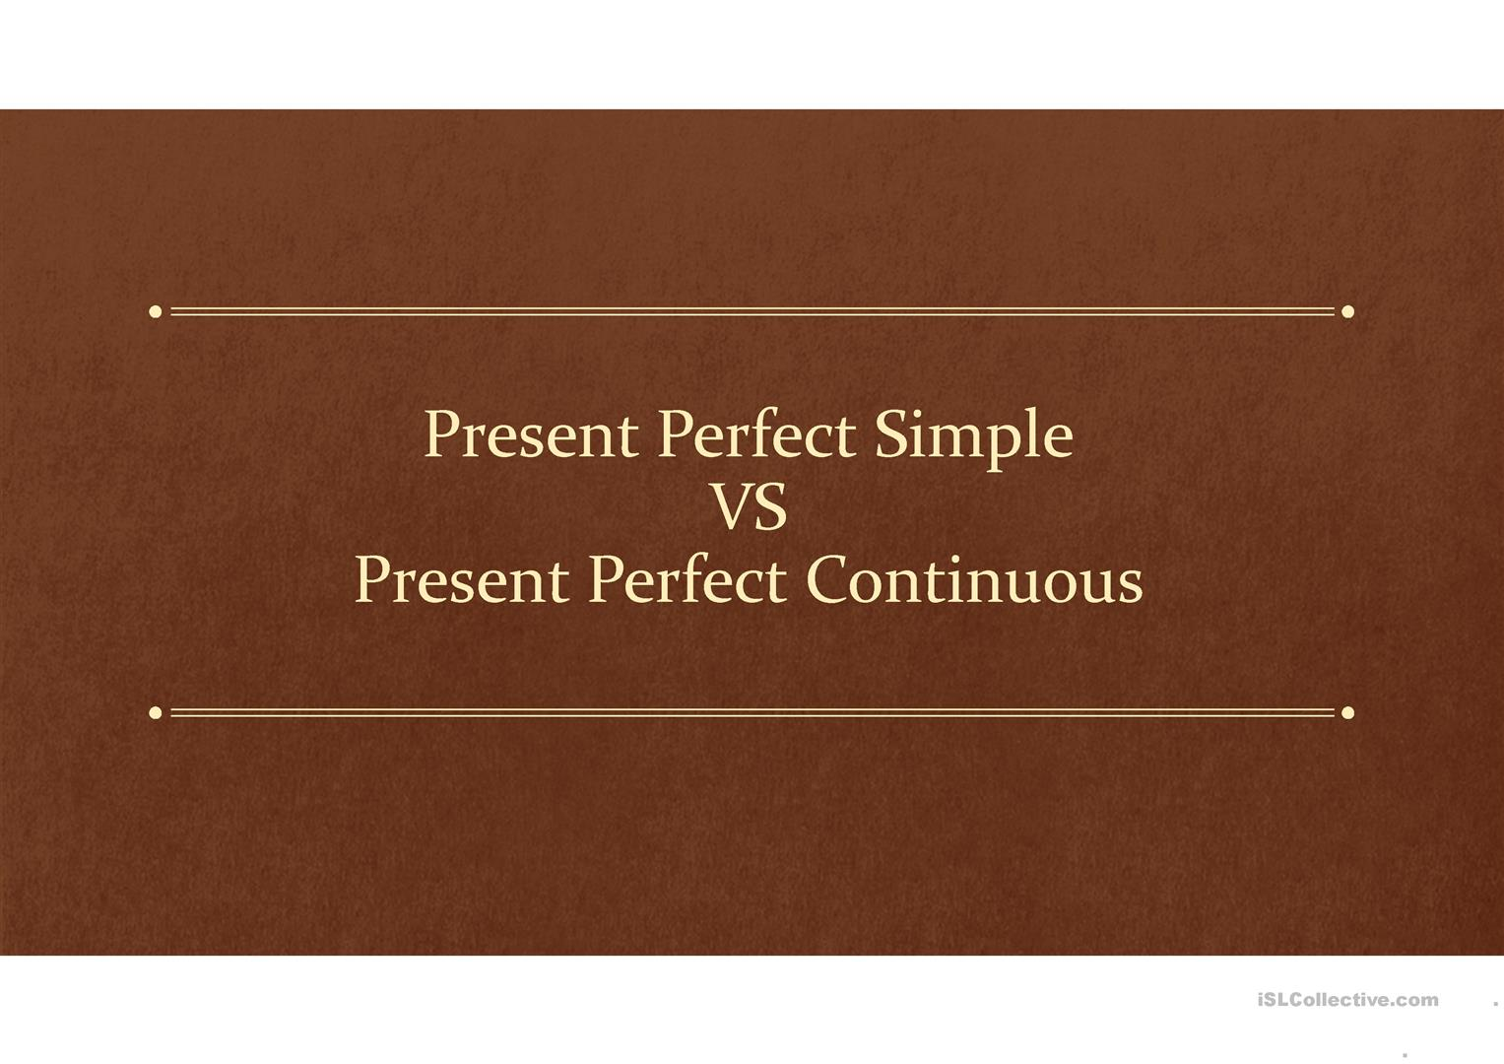

Slide 52
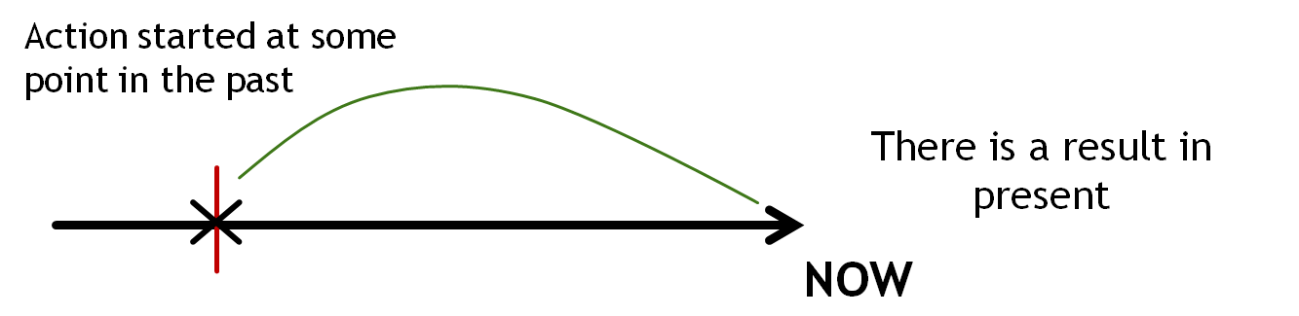
Reminder:
Present Perfect, when to use it?
When there is a connection between the past and a present event.
Whenever we want to mention an experience we think we might repeat.
When the action is recent or has just finished before the speaking time.
If we want to emphasize the duration of the action (sth that started in the past, continues in the present and may continue in the future)

Slide 53
Present Perfect Simple Form
I
You
We
They
He
She
It
have (not)
has (not)
V
I have left/ repaired
They have left/ repaired
She has left/ repaired
Past participle
ed (regular)
Present Perfect Continuous Form
I
You
We
They
He
She
It
have (not)
has (not)
V
I have been waiting
You have been waiting
He has been waiting
been
ing

Slide 54



Usage of Present Perfect Simple
We have painted the flat.
All the rooms are painted now.
to emphasize the result of the action which is complete now

Slide 55

Usage of Present Perfect Continuous
We have been painting the flat. That’s why it smells.
We still have 2 rooms to paint
to emphasize the duration of the action which started in the past and may or may not be completed by now

Slide 56
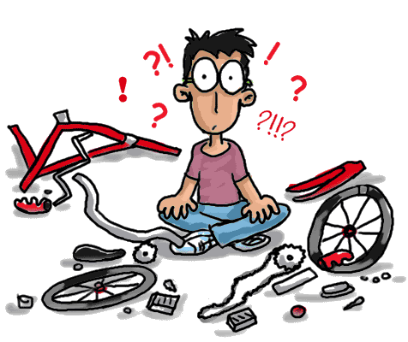
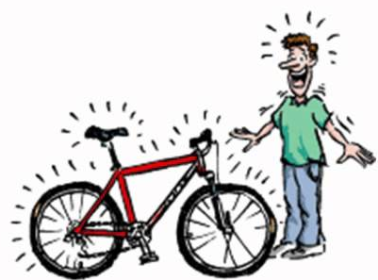
Usage and difference
Present Perfect Continuous
Present Perfect Simple
Tom has been mending his bike all day
Tom has mended his bike
Tom /To Mend?
Tom /To Mend?

Slide 57

Common mistakes
I have cut my finger. It hurts
I have been cutting my finger. It hurts
I have fallen from the tree
I have been falling from the tree
He has been breaking his leg
He has broken his leg
Short actions aren’t used in Present Perfect Continuous

Slide 58
Common mistakes
I have known him all my life
I have been knowing him all my life
I have been believing in God since childhood
I have believed in God since childhood
This house has always belonged to our family
This house has always been belonging to our family
Stative verbs aren’t used in Present Perfect Continuous

Slide 59
for/ since
We have been waiting for 2 hours
for + period of time
now
We have been waiting since 11 am.
since + point of time
now

Slide 60


Slide 61
for/ since?
since
for
… I was born
… a long time
for
since
… 10 years
… 4 o’clock
since
for
… I moved to New York
… ages
since
since
… yesterday
… 6 p.m

Slide 62

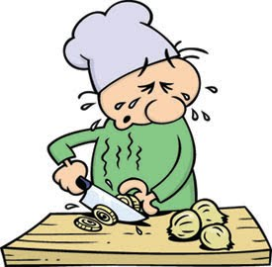
- Why are you sweating?
- Because I ….
have been sweeping the floor
sweep floor(s)
- Are the floors clean?
- Yes, Tim…
has swept the floors
- Are the onions ready?
- Yes, I ….
have peeled them
- Why are your eyes red?
- Yes, I ….
have been peeling the onions
peel onions

Slide 63
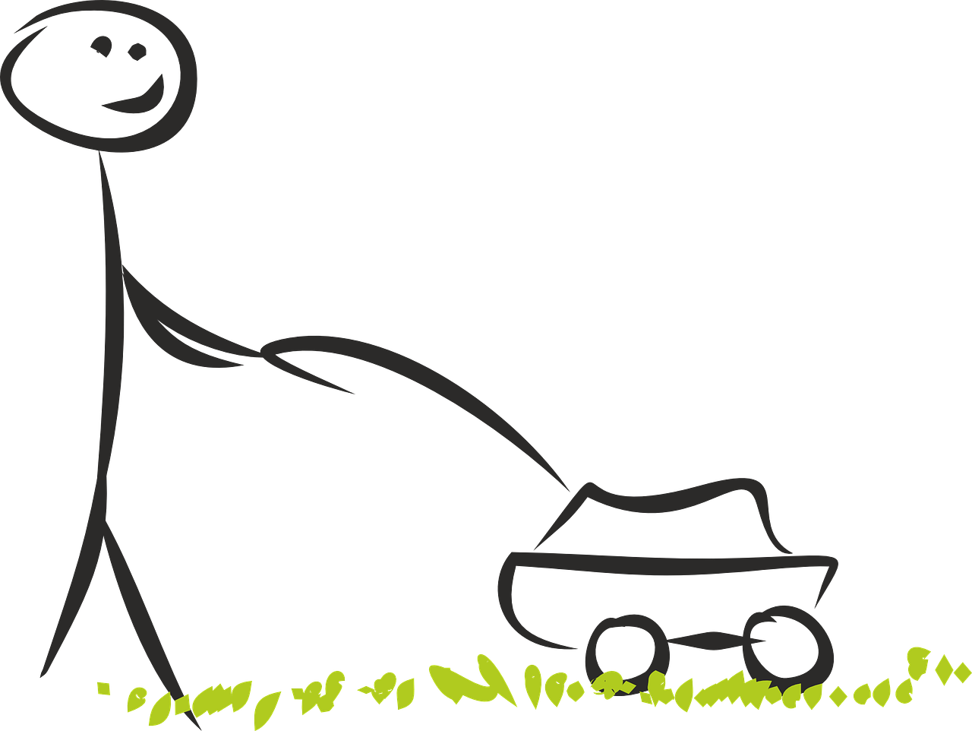
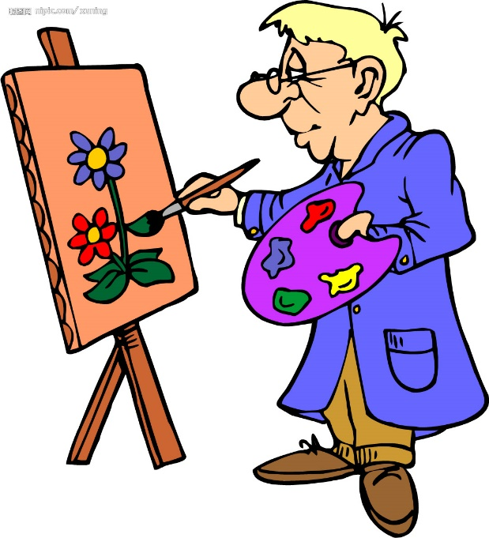
- Why do you look so tired?
- Because I ….
have been cutting the grass
Cut the grass
- Is the lawn finished?
- Yes, I ….
have cut the grass
- Why do you have paints on your hands?
- Because I ….
have been painting a picture for
an hour
- Is the picture ready?
- Yes, I ….
have drawn the picture
Paint

Slide 64


NOW YOU TELL ME:
WITH TODAY OFF WORK,
ANNE.... ALL AFTERNOON.
THAT WAS FAST!!! SHE’S....
A. SHE'S READ A BOOK.
B. SHE'S BEEN READING A BOOK.

Slide 65


NOW YOU TELL ME:
THE COFFEE IS GONE!
HE’S...
HE NEEDS TO SLOW DOWN! HE’S...
A. HE'S BEEN DRINKING COFFEE.
B. HE'S DRUNK THE COFFEE.

Slide 66


NOW YOU TELL ME:
WHAT HAPPENED, JOE? WHY ARE YOU SO MESSY? JOE HAS...
OOH! THESE LOOK DELICIOUS.
JOE HAS...
A. JOE HAS COOKED PANCAKES
B. JOE HAS BEEN COOKING

Slide 67


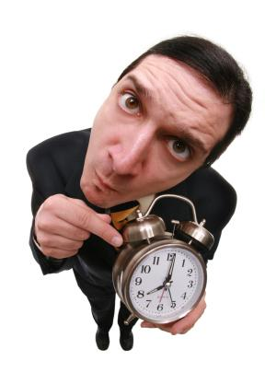

NOW YOU TELL ME:
YOUR BOSS IS MAD! WORK STARTS AT 9:00 AND IT’S 9:15.
YOU HAVE...
3 TIMES THIS WEEK IS TOO MUCH! YOU HAVE...
A. YOU HAVE BEEN ARRIVING LATE FOR WORK.
B. YOU HAVE ARRIVED LATE FOR WORK.

Slide 68


NOW YOU TELL ME:
ALL SET!!
THE CAR WAS BROKEN BUT NOW IT’S FIXED. SHE’S...
WHAT’S THE WRENCH FOR? OH, SHE’S...
A. SHE'S BEEN FIXING THE CAR.
B. SHE'S FIXED THE CAR.

Slide 69
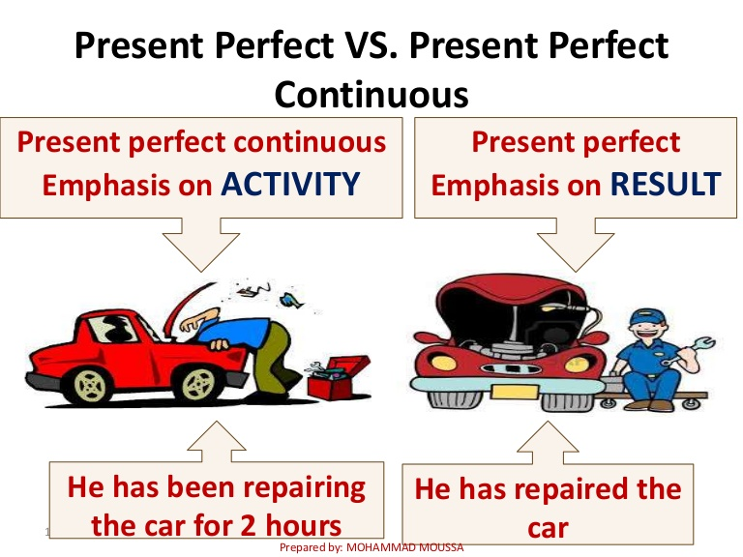
To wrap up:

Slide 70

Remember..
“Mental health is not a destination, but a process. It's about how you drive, not where you're going.”
- Noam Shpancer

Slide 71

THANK YOU!
Any Questions?

